Slide 1
Data Structure and Algorithms
(CS212)
Instructor : Syed Musharaf Ali
ROOM G-104-DSE IIUI
Ph# 051-9019724 Ext-2724
Email: musharaf.ali@iiu.edu.pk

Slide 2
Spanning Tree
https://www.tutorialspoint.com/data_structures_algorithms/spanning_tree.htm
A spanning tree is a subset of Graph G, which has all the vertices covered (connected) with minimum possible number of edges.
Hence, a spanning tree does not have cycles and it cannot be disconnected.
By this definition, we can draw a conclusion that every connected and undirected Graph G has at least one spanning tree.
A disconnected graph does not have any spanning tree, as it cannot be spanned to all its vertices.

Slide 3
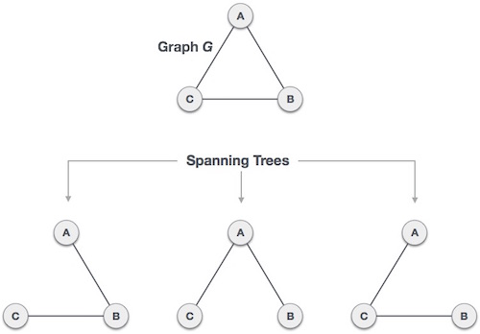
Spanning Tree
https://www.tutorialspoint.com/data_structures_algorithms/spanning_tree.htm

Slide 4
Spanning Tree
https://www.tutorialspoint.com/data_structures_algorithms/spanning_tree.htm
General Properties of Spanning Tree
We now understand that one graph can have more than one spanning tree. Following are a few properties of the spanning tree connected to graph G −
A connected graph G can have more than one spanning tree.
All possible spanning trees of graph G, have the same number of edges and vertices.
The spanning tree does not have any cycle (loops).
Removing one edge from the spanning tree will make the graph disconnected, i.e. the spanning tree is minimally connected.
Adding one edge to the spanning tree will create a circuit or loop, i.e. the spanning tree is maximally acyclic.

Slide 5
Spanning Tree
https://www.tutorialspoint.com/data_structures_algorithms/spanning_tree.htm
Minimum Spanning Tree (MST)
In a weighted graph, a minimum spanning tree is a spanning tree that has minimum weight than all other spanning trees of the same graph.
In real-world situations, this weight can be measured as distance, congestion, traffic load or any arbitrary value denoted to the edges.

Slide 6
Spanning Tree
https://www.tutorialspoint.com/data_structures_algorithms/spanning_tree.htm
Kruskal's Spanning Tree Algorithm
Kruskal's algorithm to find the minimum cost spanning tree uses the greedy approach.
This algorithm treats the graph as a forest and every node it has as an individual tree.
A tree connects to another only and only if, it has the least cost among all available options and does not violate MST properties.

Slide 7
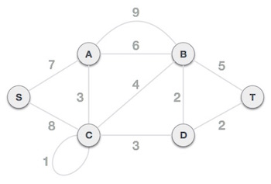
Spanning Tree
https://www.tutorialspoint.com/data_structures_algorithms/spanning_tree.htm
Kruskal's Spanning Tree Algorithm
To understand Kruskal's algorithm let us consider the following example −

Slide 8
Spanning Tree
https://www.tutorialspoint.com/data_structures_algorithms/spanning_tree.htm
Kruskal's Spanning Tree Algorithm
Steps:
Step 1 - Remove all loops and Parallel Edges
Step 2 - Arrange all edges in their increasing order of weight
Step 3 - Add the edge which has the least weightage
Step 4 – Avoid loops
Complete solution :
https://www.tutorialspoint.com/data_structures_algorithms/kruskals_spanning_tree_algorithm.htm

Slide 9
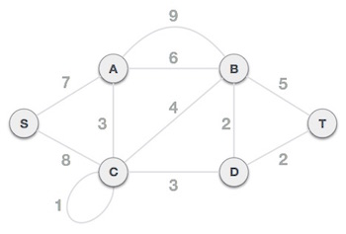
Spanning Tree
https://www.tutorialspoint.com/data_structures_algorithms/spanning_tree.htm
Prim's Spanning Tree Algorithm
To contrast with Kruskal's algorithm and to understand Prim's algorithm better, we shall use the same example −

Slide 10
Spanning Tree
https://www.tutorialspoint.com/data_structures_algorithms/spanning_tree.htm
Prim's Spanning Tree Algorithm
Steps
Step 1 - Remove all loops and parallel edges
Step 2 - Choose any arbitrary node as root node
Step 3 - Check outgoing edges and select the one with least cost
Source: https://www.tutorialspoint.com/data_structures_algorithms/prims_spanning_tree_algorithm.htm

Slide 11
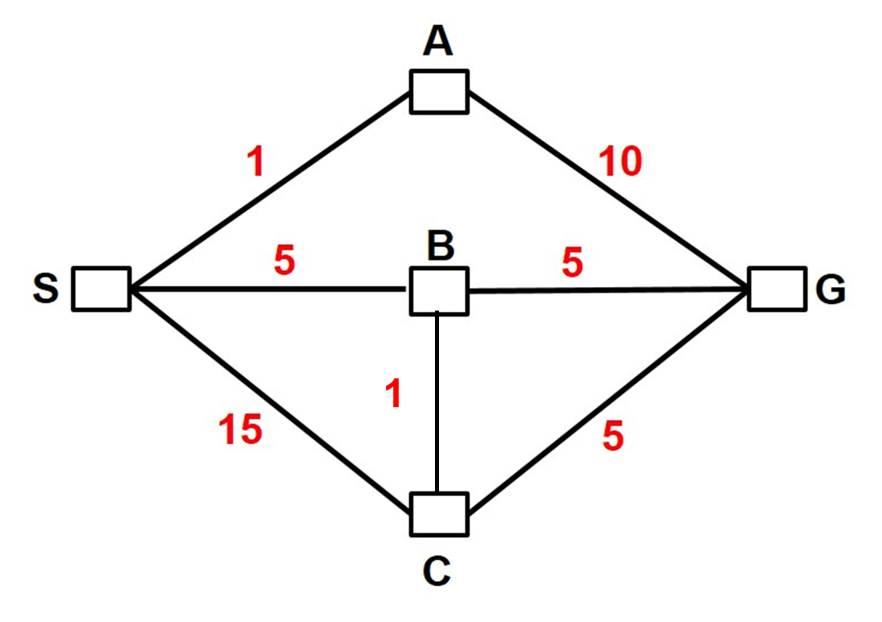
Assignment
https://www.tutorialspoint.com/data_structures_algorithms/spanning_tree.htm
Find the minimum spanning tree of the following graph using
Prim's Spanning Tree Algorithm
Kruskal's Spanning Tree Algorithm

